Slide 1


Detection of malicious Social Bots

Slide 2
Abstract
With the significant and rapid increase in the volume and velocity of data in social network, there have been significant changes in the methodology of collecting and analysing data.
The current social networks are using various designs for collecting large data. Social bots are one of the current ways used to collect user information. However malicious social bots have also been used to disseminate false information and this can result in real-world consequences.
Therefore, detecting social bots is one of the important tasks to be done. A novel method of detecting malicious social bots featuring both selections based on transition probability of click stream sequences

Slide 3

Bots
Social bots are social accounts controlled by automated programs that can perform corresponding operations based on a set of procedures.
Bots are normally used to automate certain tasks, meaning they can run without specific instructions from humans. An organization or individual can use a bot to replace a repetitive task that a human would otherwise have to perform. Bots are also much faster at these tasks than humans.

Slide 4
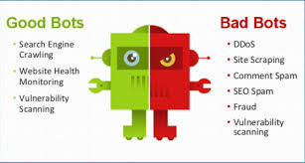
Good bots VS Malicious Bots

Slide 5
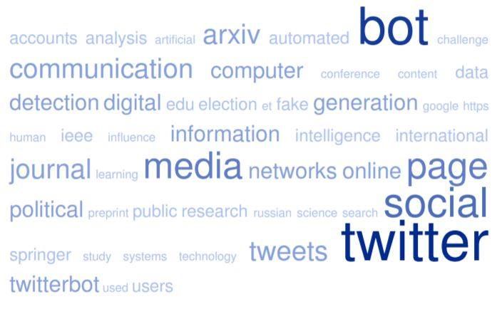
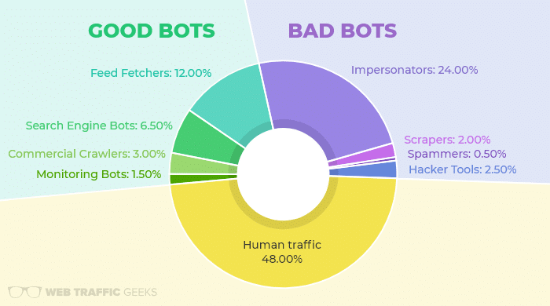
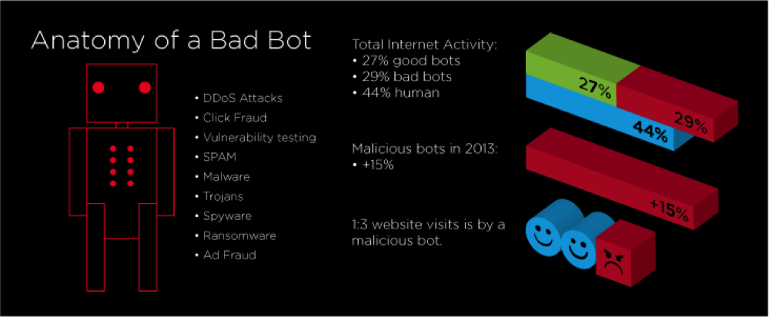

Slide 6
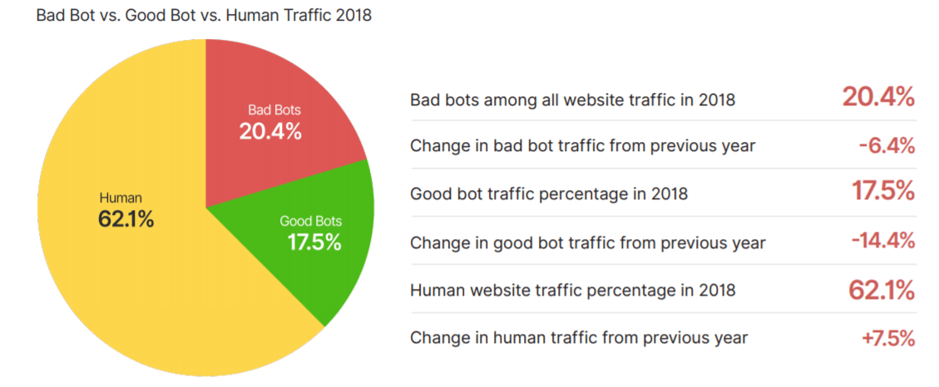
The need to detect malicious bots
Malicious social bots have been used for malicious tasks such as spreading false information about political candidates and inflating the perceived popularity of celebrities.
These bots can change the results of common analyses performed on social media. Malicious social bots have also been used to disseminate false information (e.g., fake news),collect personal data, compromise accounts, and this can result in real-world consequences. Therefore, detecting and removing malicious social bots in online social networks is crucial

Slide 7
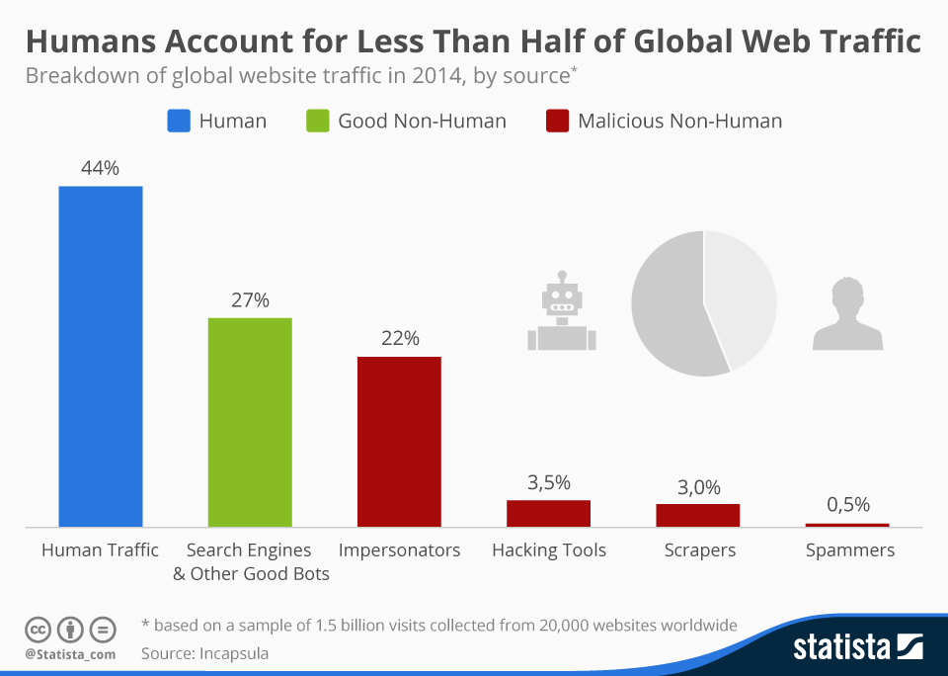


Slide 8

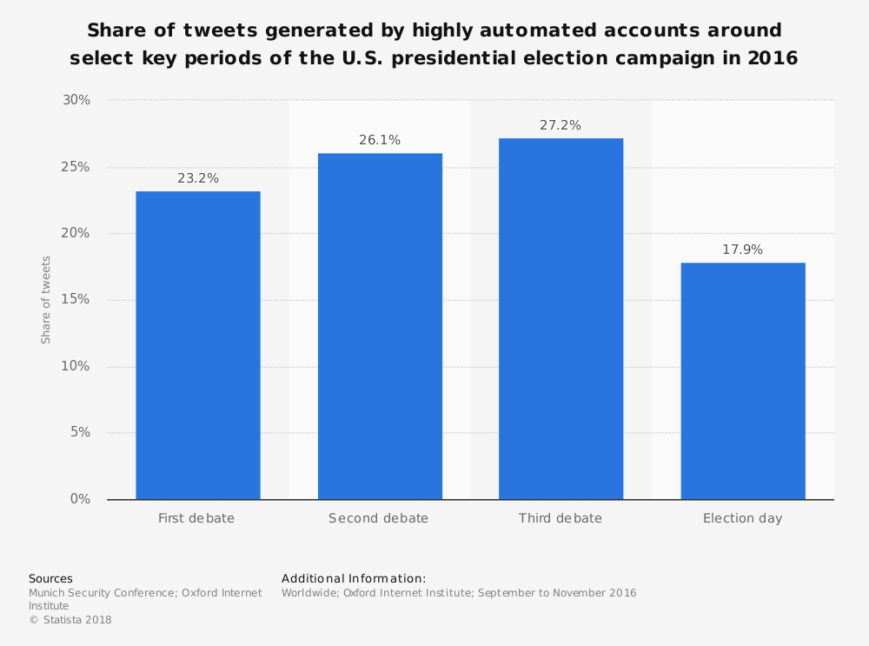
TWITTER VS MALICIOUS SOCIAL BOTS
Recent statistics show that more than 50% of Twitter accounts are not human users. By one estimate 28% of accounts created in 2008 and half of the accounts created in 2014 have been suspended by Twitter. According to the social interactions between users of the Twitter user to identify the active, passive and inactive users, a supervised machine learning method was proposed to identify social bots on the basis of age, location and other static features of active, passive, and inactive users in the Twitter, as well as interacting person, interaction content, interaction theme, and some dynamic characteristics

Slide 9
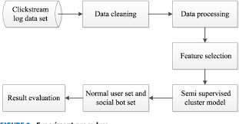
EXPERIMENTAL DESIGN FOR DETECTING MALICIOUS BOTS
Social bots that perform a single task, malicious social bots that coordinate to perform tasks, and malicious social bots that perform mixed tasks. For example, a user can perform two or more actions in the actions of liking, comment, sharing and so on. The social bot for malicious likes, the value of the P(play, like) (the transition probability of ‘‘the current click event is and the next click event is liking’’) would be high and the value of other transition probability features would be small or zero.

Slide 10

MALICIOUS SOCIAL BOTS DETECTION
1) Data cleaning:
Data that are clicked less must be cleaned to remove wrong data, obtain accurate transition probability between clickstreams, and avoid the error of transition probability caused by fewer data

Slide 11

MALICIOUS SOCIAL BOTS DETECTION
2) Data processing:
Some data are selected randomly from the normal user set and social bots set to the label. Normal user account is labeled as 1, and the social bots account is labeled as −1. Seed users are classified as the category of clusters.

Slide 12

MALICIOUS SOCIAL BOTS DETECTION
3) Feature selection:
In the spatial dimension: according to the main functions of the CyVOD platform, we select the transition probability features related to the playback function: P(play, play), P(play, like) , P(play, feedback), P(play, comment), P(play, share) and P(play, more) ; in the time dimension: we can get the inter-arrival times (IATs). Because if all transition probability matrixes of user behavior are constructed, extremely huge data size and sparse matrix can increase the difficulty of data detection.

Slide 13
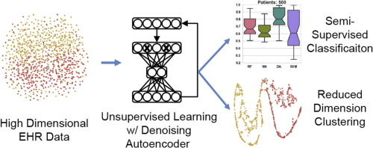
MALICIOUS SOCIAL BOTS DETECTION
4) Semi-supervised clustering method:
First, the initial centers of two clusters are determined by labeled seed users. Then, unlabeled data are used to iterate and optimize the clustering results constantly.

Slide 14
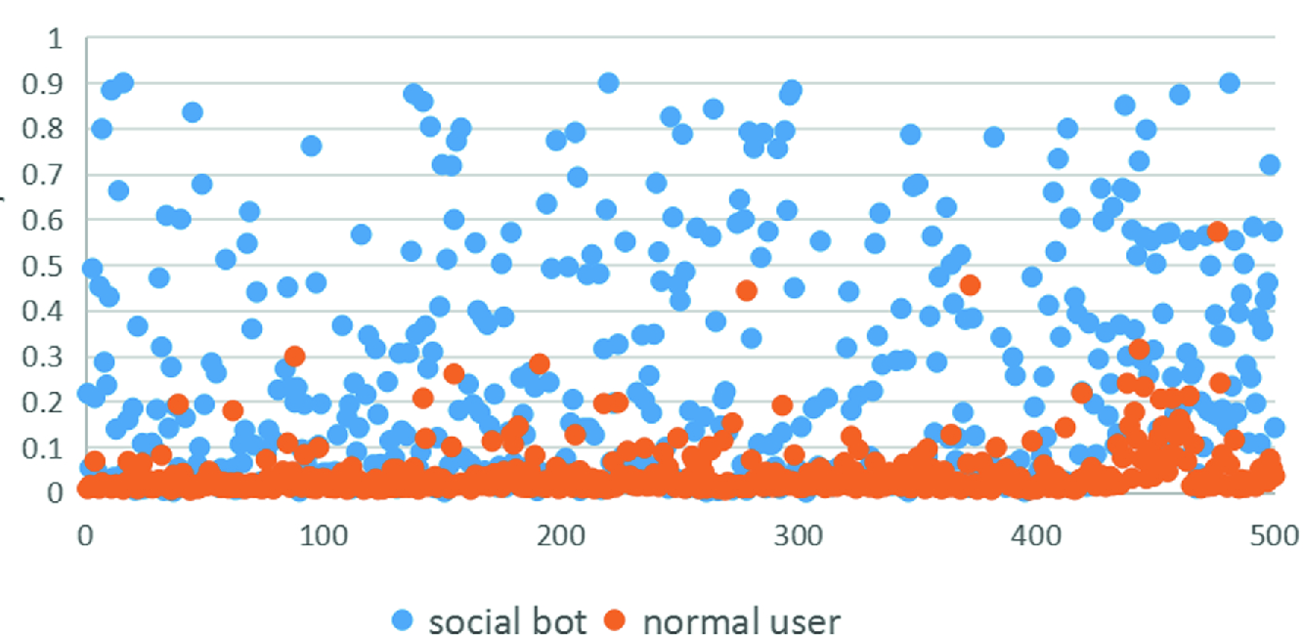
MALICIOUS SOCIAL BOTS DETECTION
5) Obtain the normal user set and social bots set:
The normal user set and social bots set can be finally obtained by detecting

Slide 15
MALICIOUS SOCIAL BOTS DETECTION
6) Result evaluation:
We evaluate results based on three different metrics: Precision, Recall, and F1 Score (F1 is the harmonic average of Precision and Recall, F1 = 2*Precision*Recall Precision+Recall).

Slide 16
CONCLUSION
The above method detects malicious social bots in online social networks. The following method can be used to detect various social bots (malicious) on various websites and social networks

